Slide 1
Binding Affinities of Coronaviruses on the Human Receptor ACE2
Bowen Bao

Slide 2
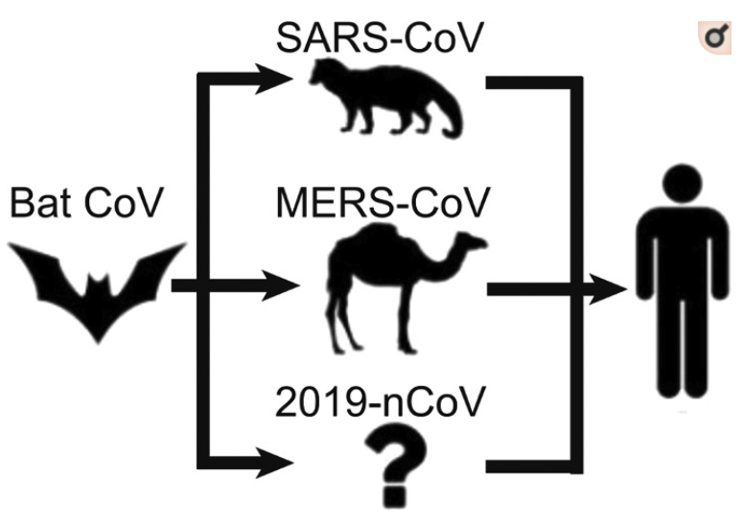
Covid-19 Intermediary Host
Picture from: Zhang, Chengxin et al. “Protein Structure and Sequence Reanalysis of 2019-nCoV Genome Refutes Snakes as Its Intermediate Host and the Unique Similarity between Its Spike Protein Insertions and HIV-1.” Journal of proteome research vol. 19,4 (2020): 1351-1360. doi:10.1021/acs.jproteome.0c00129

Slide 3
Problem
2019-nCoV infects the host cells through the interaction between the spike surface glycoprotein (S protein) and the human ACE2 receptor.
The spike protein binds to the human cell receptor, enters the human cell and begins infection.
It is the main component responsible for neutralizing host immune responses and primarily determines the infectivity of the coronavirus.
This study analyzes the binding energy between ACE2 and
(1) the bat coronavirus
(2) the pangolin coronavirus
(3) SARS CoV (2002)
(4) SARS CoV-2 (2019)

Slide 4
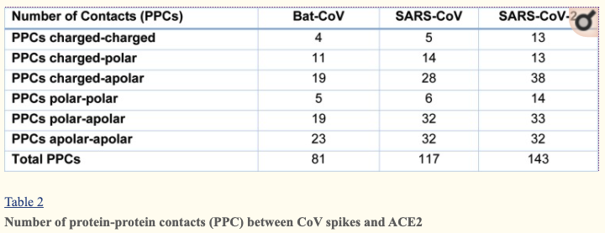
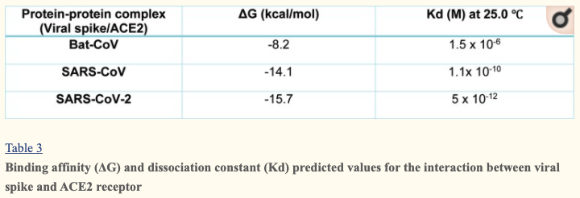
Previous Research

Slide 5
Comparing the Four Sequences
SARS CoV-2 (2019)
SARS CoV (2002)
Pangolin CoV
MERS
Bat CoV

Slide 6
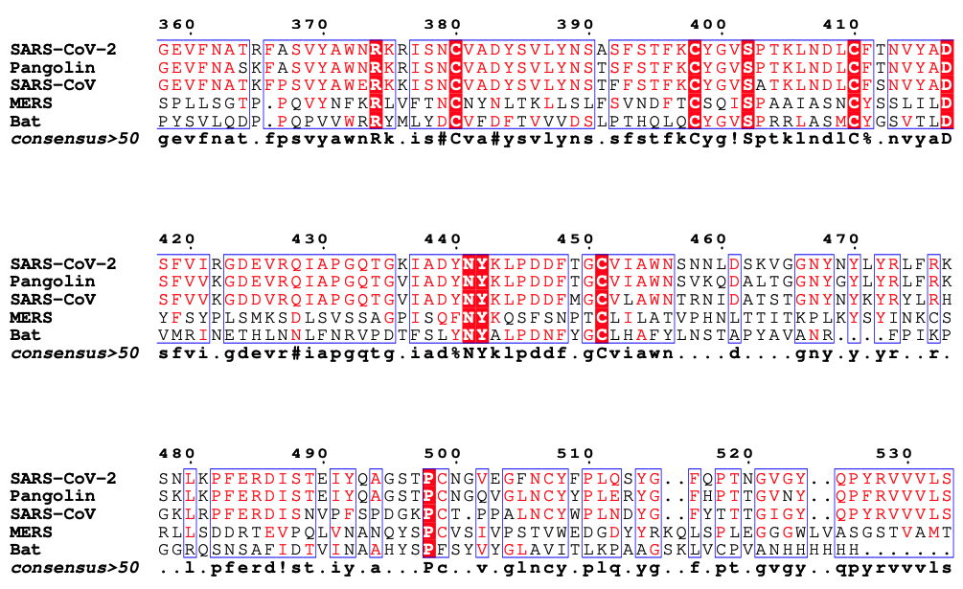
Binding Sites (Receptor Binding Domain)
Binding Sites
Green – SARS Cov-2
Red – SARS Cov

Slide 7
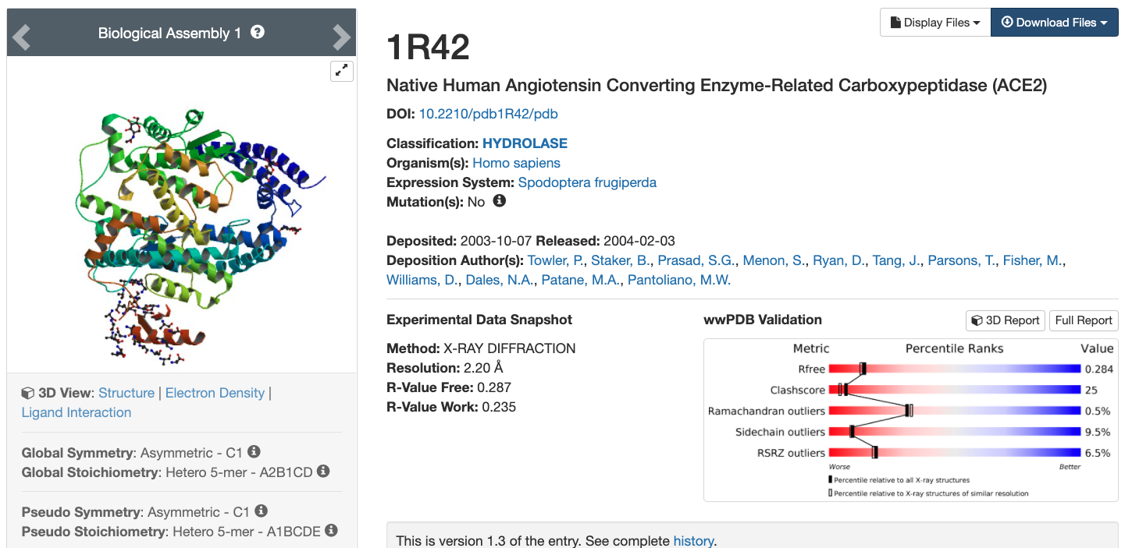
Human – ACE2 (1R42)

Slide 8
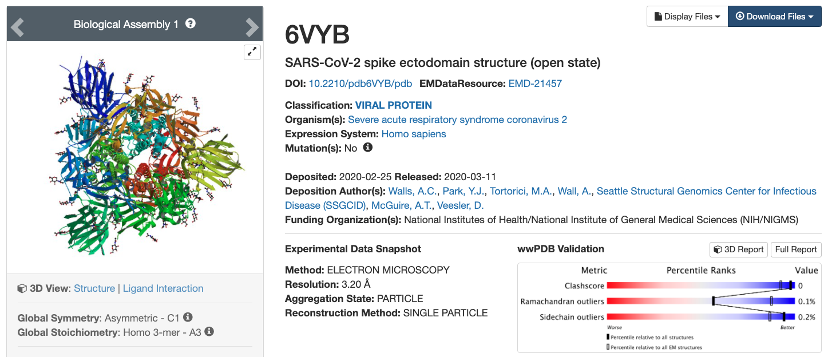
SARS-CoV-2 Spike Protein Open (6VYB)

Slide 9
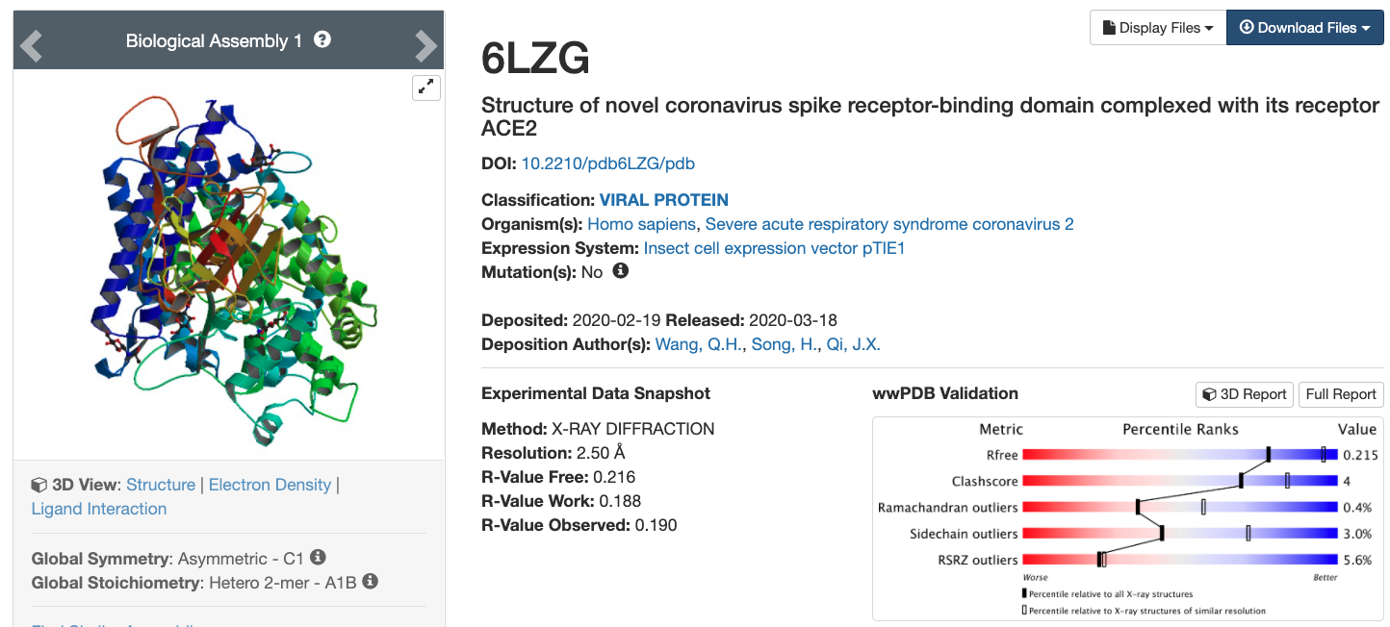
ACE2 and CoV-2 Spike Protein (6LZG)

Slide 10
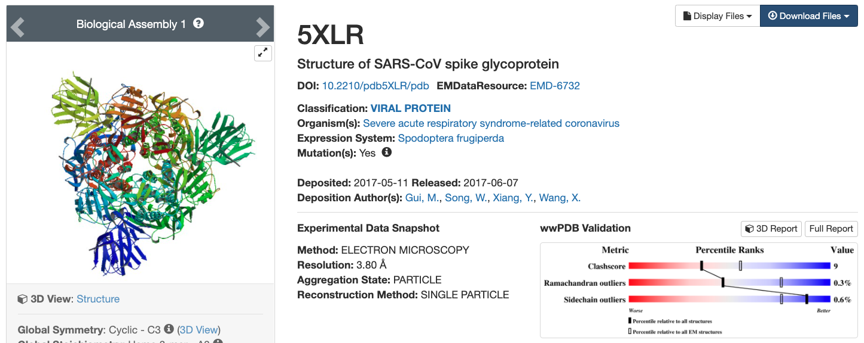
SARS CoV (5XLR)

Slide 11
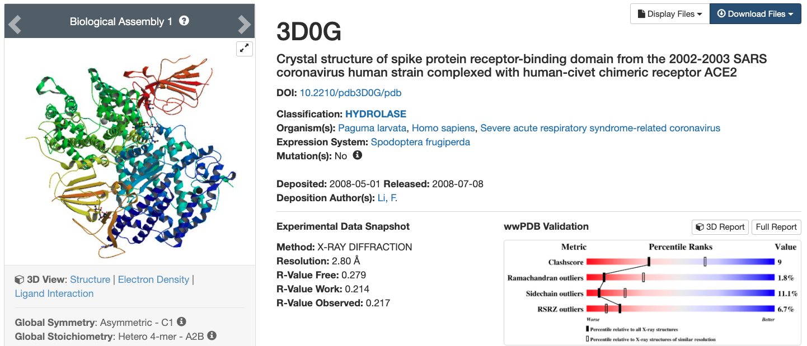
SARS Spike Protein and ACE2 Interaction (3D0G)

Slide 12
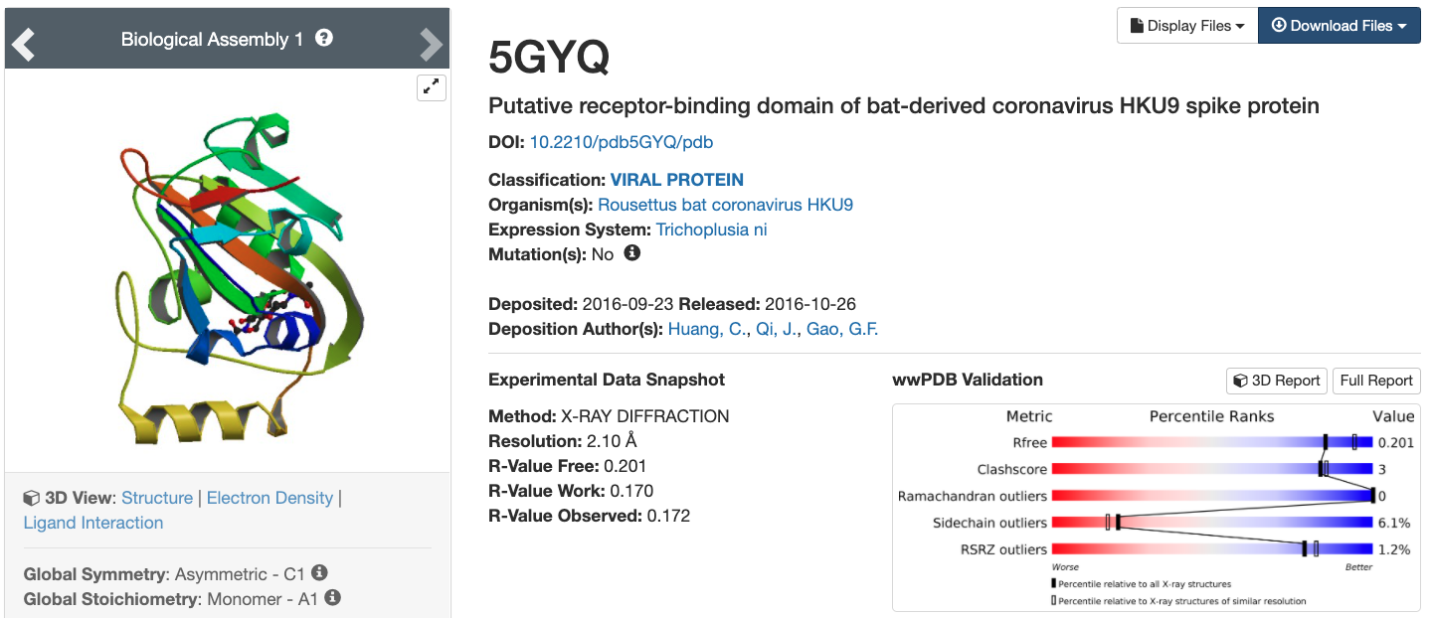
Bat Spike Protein (5GYQ)

Slide 13
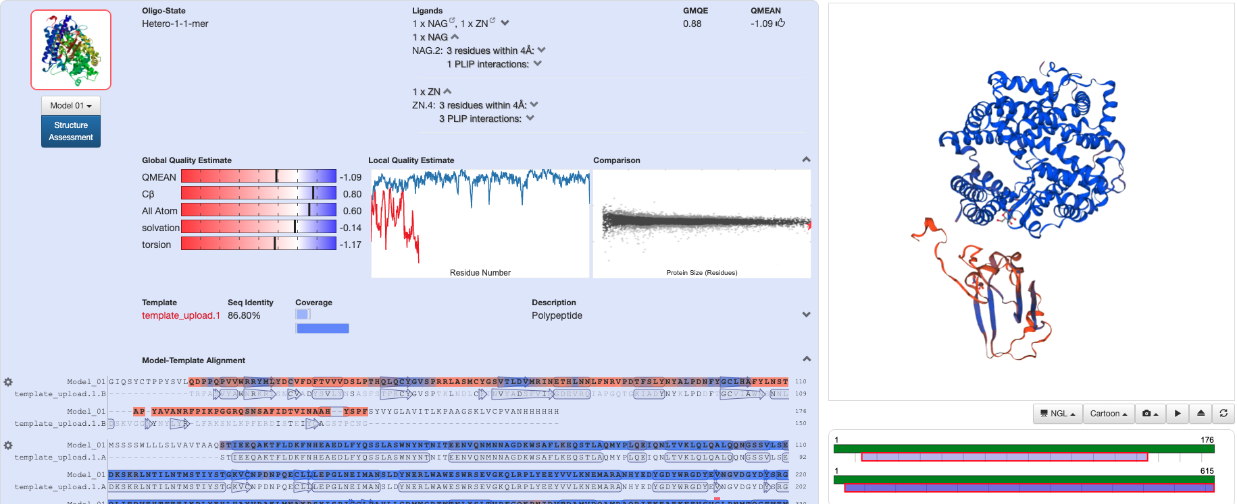
Bat Spike Protein and ACE2 Interaction

Slide 14
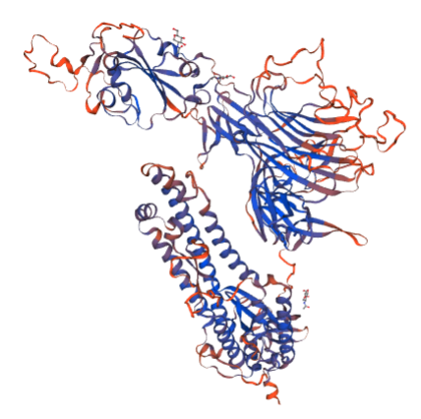
Pangolin Spike Protein
FASTA: https://www.ncbi.nlm.nih.gov/protein/QIQ54048.1?report=fasta
Not found on PDB
Built using Swiss Model after removing the missing ‘X’s
Uses Covid 19 (6VYB) Fasta file as template
PDB File from Swiss Model downloaded for energy analysis

Slide 15
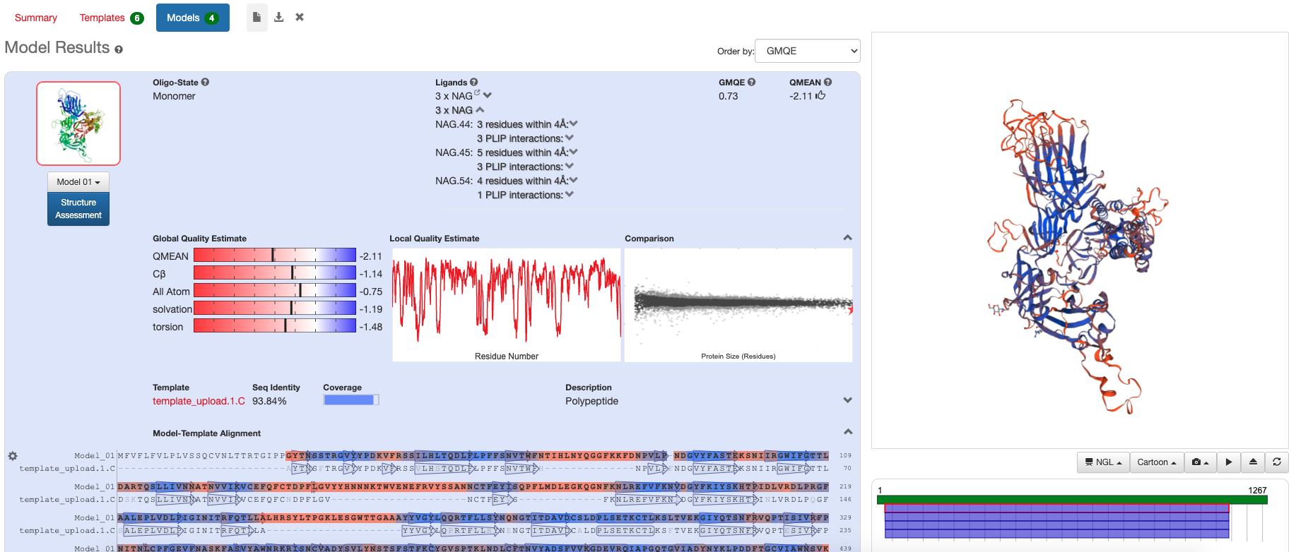
Pangolin – Swiss Model

Slide 16
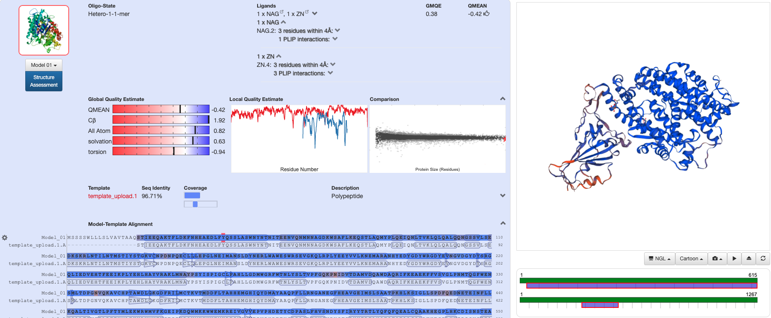
Pangolin Spike Protein and ACE2 Interaction

Slide 17
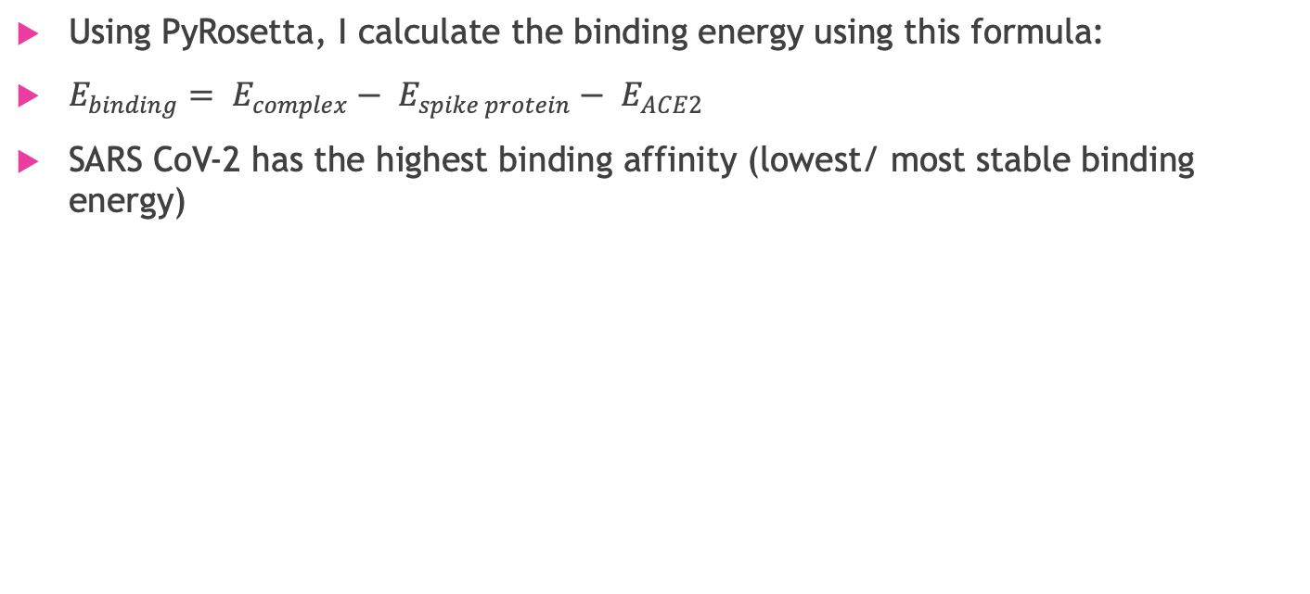
Results
Using PyRosetta, I calculate the binding energy using this formula:
$E_{binding}= E_{complex}− E_{spike protein}− E_{ACE2}$
SARS CoV-2 has the highest binding affinity (lowest/ most stable binding energy)

Slide 18
Discussion
Research of role of pangolins has only recently emerged
Most studies studies are on the crystal structures
Very little research has been done studying the binding affinity
Further research - can study the binding affinities of the interaction residues

